Slide 1

Databases

Slide 2
Database Relational Database
Relational databases are used to store data in a fixed columnar way, it includes
Database
Tables
Rows
Fields
ID | Captain | Team Name | Win %
1 | Rohit Sharma | Mumbai Indians | 50%
2 | Kane Williamson | Sun Risers Hyderabad | 45%
3 | MS Dhoni | Chennai Super Kings | 58%
4 | Gautam Gambhir | Kolkata Knight Riders | 40%
5 | Gautam Gambhir | Delhi Capitals | 10%
.. | .. | .. | ..

Slide 3
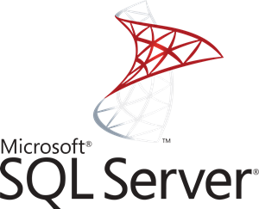


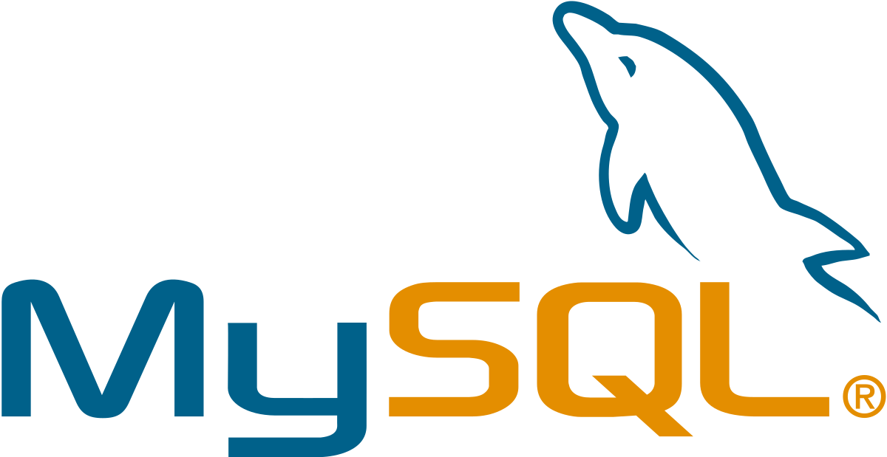


Database Major Types of Relational Database Types
Microsoft SQL Server
PostgreSQL
MySQL
MariaDB
Oracle
Aurora

Slide 4
Database Non-Relational Database
A non-relational database is a database that does not use the tabular schema of rows and columns found in most traditional database systems.
Database
Collection
Document
Key Value Pairs
{
“_id”: “1”,
“name”: “MS Dhoni”,
“team”: “Chennai Super Kings”,
“stats”: [
{“win%”:”58%”, “won games”: “100”,}
]
}

Slide 5
Database Non-Relational Database
A non-relational database is a database that does not use the tabular schema of rows and columns found in most traditional database systems.
Database
Collection
Document
Key Value Pairs
{
“_id”: “1”,
“name”: “MS Dhoni”,
“team”: “Chennai Super Kings”,
“stats”: [
{“win%”:”58%”, “won games”: “100”,}
]
}

Slide 6
Databases LAB - 1
Go to RDS
Hit create database
Select a type of database
Select Dev/Test DB
Choose t2.micro DB
Leave the rest as defaults
Provide “test” in all fields, hit next
Change the DB name to “test”,
Turns Backups-off, select 0 days
Disable monitoring
Leave rest as default, hit create
Create an EC2 instance
Using Bootstrap install Wordpress
Add security group permission in RDS SG
Go to RDS -> Connectivity
Copy the endpoint URL
Use the EC2 IP and open in browser
In database details, DB, username, and password as test
In DB Host – type the endpoint
Copy the wp-config.php contents
SSH into the EC2 instance
Go to webroot create a wp-config.php file and then paste the contents
Go to the website again, hit Run installation
Provide rest of the details. Then hit install
Notes:
#!/bin/bash
yum install httpd –y
Amazon-linux-extras install –y php7.2
cd /var/www/html
wget https://wordpress.org/latest.tar.gz
tar -xzf latest.tar.gz
cp -r wordpress/* /var/www/html/
rm -rf wordpress
rm -rf latest.tar.gz
chmod -R 755 wp-content
chown -R apache:apache wp-content
service httpd start
chkconfig httpd on

Slide 7
Databases LAB - 2
Go to RDS
Select the DB created
Click on Modify
Turn on Multi-AZ, hit modify
Reboot with failover
Next modify again,
Turn on Backup – 35 days
Go to the dashboard, click on actions, hit create read replica
Select regions,
Turn public access to no,
Give a DB instance name “test-rr”
Actions -> Promote read replica
Delete the read replica
Automated Backups
Snapshots
Read Replicas
Notes:
#!/bin/bash
yum install httpd php php-mysql –y
cd /var/www/html
wget https://wordpress.org/latest.tar.gz
tar -xzf latest.tar.gz
cp -r wordpress/* /var/www/html/
rm -rf wordpress
rm -rf latest.tar.gz
chmod -R 755 wp-content
chown -R apache:apache wp-content
service httpd start
chkconfig httpd on

Slide 8
Database Dynamo DB
Dynamo DB is a NoSQL database offering from Amazon that
Is stored on SSD Storage
Spread across 3 geographically distinct data centres
Eventual Consistent Reads (Default): Takes 1 sec
Strongly Consistent Reads: Less than 1 sec

Slide 9
Database Redshift
Amazon Redshift is a fully managed petabyte-scale data warehouse service. Redshift is designed for analytic workloads and connects to standard SQL-based clients and business intelligence tools.
Used as a replacement for OLAP type DBs
Cab be Single Node (160 GB)
Multi-node
Leader Node (managed client connections and received queries)
Compute Node (store data and perform queries)
Uses advanced columnar compression
Comes with Massive parallel processing providing easy scale out
Backups are default with 1 day retention period
Maximum retention period is 35 days
Redshift tries to keep at least 3 copies of the data
Can also asynchronously replicate snapshots to S3 in another region for DR
Redshift is only available in one AZ
Snapshots can be restored to a new AZ

Slide 10
Database Aurora
Amazon Aurora is a MySQL and PostgreSQL-compatible relational database built for the cloud, that combines the performance and availability of traditional enterprise databases with the simplicity and cost-effectiveness of open source databases.
Built from scratch
Starts with 10GB to 64 TB (Autoscaling)
Always keeps 2 copies in each availability zone in 3 Azs
Extremely HA – designed to handle loss of upto two copies without affecting write, and three copies without affecting read
Aurora storage is self-healing
Two types of read replicas (Aurora, or MySQL replicas)
Automated backups are always enabled
Backups and snapshots does not affect performance

Slide 11
Database Elasticache
Amazon ElastiCache is a fully managed in-memory data store and cache service by Amazon Web Services. The service improves the performance of web applications by retrieving information from managed in-memory caches, instead of relying entirely on slower disk-based databases.
Supports two open-source in-memory caching engines
Memcached
Redis
It is used to improve application and DB performance
Redis is Multi-AZ,
For horizontal scaling Memcached is used

Slide 12
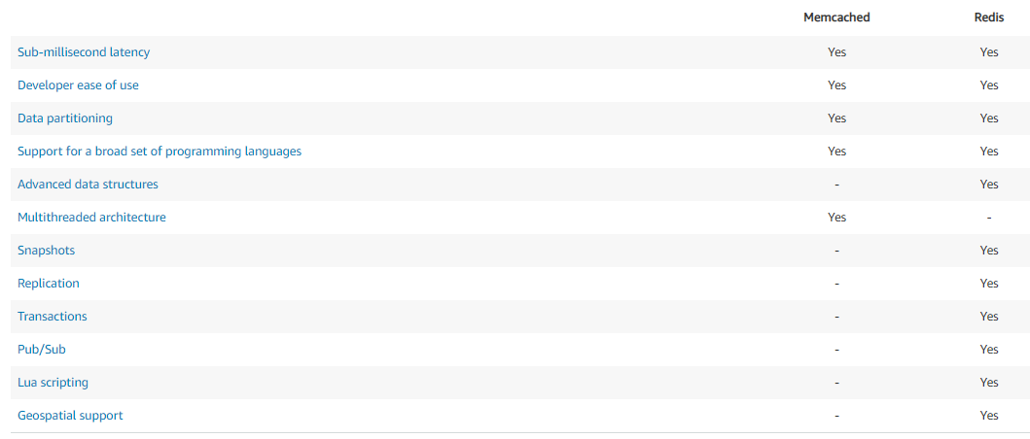
Database Memcached vs Redis

